Slide 1


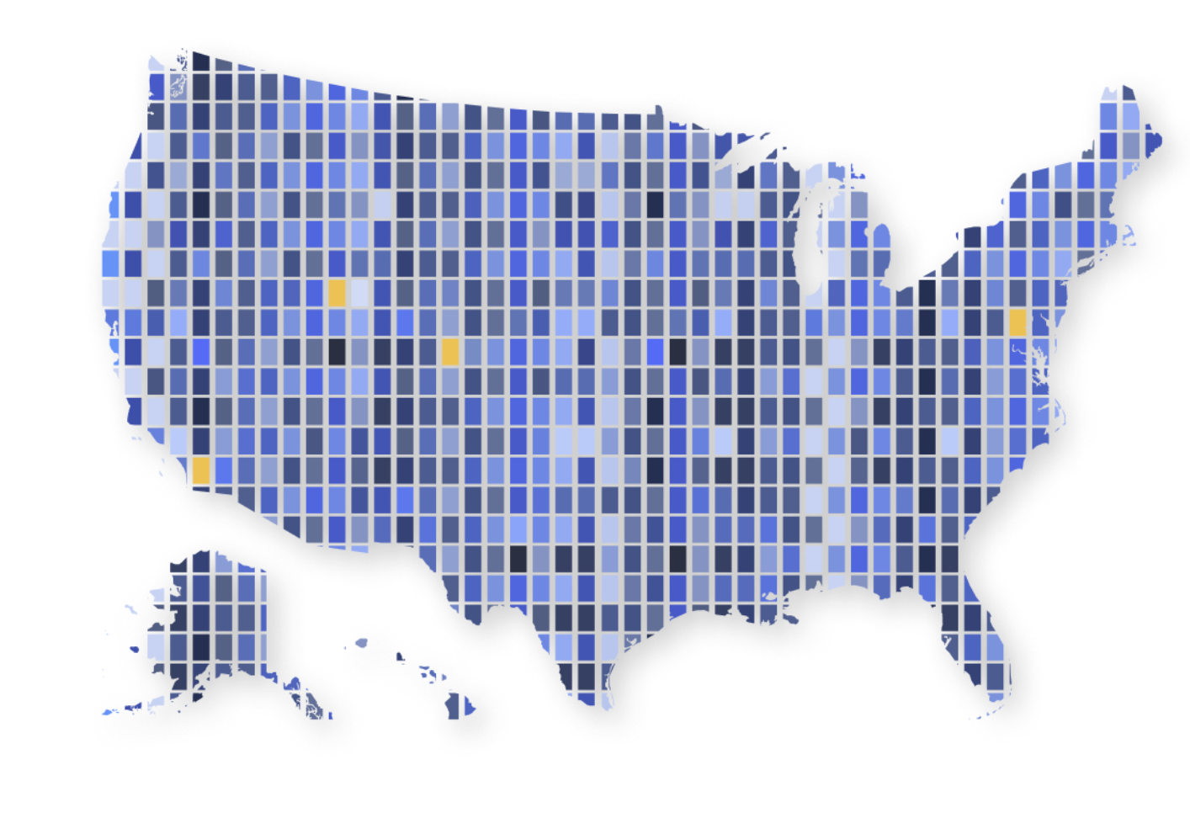


National Data Platform EndPoints

Slide 2
What are NDP EndPoints?
NDP EndPoints (EP) are unified access interfaces that provide seamless integration with the National Data Platform ecosystem.

Slide 3
Key Concept
EndPoints serve as gateway tools that simplify and standardize interactions with the NDP infrastructure, enabling users and systems to:
Connect to multiple CKAN catalogs (Local, Pre-CKAN, NDP Central)
Manage datasets through a single, streamlined interface
Ingest new data into the platform with automated workflows
Discover and search existing datasets across federated catalogs
Integrate external services (Kafka, S3, JupyterLab, APIs)

Slide 4
NDP EP Stack
Three-Layer Architecture:
EP-API: REST API - 1
EP-Frontend: Administrative Web Console - 2
EP-Python Library: Programmatic Integration - 3
1 - https://github.com/national-data-platform/ep-api
2 - https://github.com/national-data-platform/ep-frontend
3 - https://github.com/national-data-platform/ep-py
Note: A local CKAN installation is also needed

Slide 5
NDP EP Stack
NDP AAI
Authorization
NDP EP-Frontend (Admin console)
NDP EP-API
Register
NDP Pre-CKAN
NDP EP-Python
Full management
Search
Register after QC checks
NDP Catalog (CKAN)
Local CKAN

Slide 6
NDP EP Features
🔍 SEARCH AND QUERY
Dataset Search
Organization Listing
Search datasets by multiple criteria
By name, title, organization
By resource type, format, description
Free-text search terms
Temporal and custom filters
Support for multiple servers (local, global,
pre-CKAN)
Get all organizations
Optional filtering by name
Support for multiple servers (local, global, pre-CKAN)
Note: An Organization is essentially a group or entity that owns and manages datasets.

Slide 7
NDP EP Features
📝 DATASET MANAGEMENT
Create (Register) general and flexible datasets
Full update (complete replacement)
Partial update (specific fields only)
Delete datasets by ID or name
Note: NDP EP offers type-specific registration workflows for specific data sources (URLs, Kafka streams, S3 buckets) that automatically handle the appropriate metadata and configuration, plus flexible general dataset endpoints for any other CKAN-supported data type.

Slide 8
NDP EP Features
🏢 ORGANIZATION MANAGEMENT
Create new organizations
Delete organizations and their datasets
👤 USER MANAGEMENT AND AUTHENTICATION
Get authenticated user information (NEW in release - 08/31/2025)
Bearer token-based authentication system
Organization-based access control (configurable) (NEW in release - 08/31/2025)

Slide 9
NDP EP Features
🔧 SERVICE MANAGEMENT
Service Registration
Service Proxy (NEW in release - 08/31/2025)
Register services (APIs, microservices, etc.)
Includes service URL, documentation, health checks
Additional metadata and classification by types
Search services
Delete services
Redirect endpoints: Acts as a reverse proxy
/services/redirect/{service_identifier}
Forwards HTTP requests to registered services
Preserves methods, headers, and parameters

Slide 10

EP - API
docker run -p 8001:8000 rbardaji/ndp-ep-api
Advanced installation, Configuration and Tutorials: https://github.com/national-data-platform/ep-api
Note: You need a CKAN instance to act as "local CKAN"

Slide 11
EP - Frontend
Admin Web Console
docker run -p 3000:80 -e NDP_EP_API="NDP EP-API URL" \
rbardaji/ndp-ep-frontend:latest
Advanced installation, Configuration and Tutorials: https://github.com/national-data-platform/ep-frontend
Note: You need NDP EP-API up and running

Slide 12

EP - Python
pip install ndp-ep
Advanced installation, Configuration and Tutorials: https://github.com/sci-ndp/ndp-ep-py
Note: You need NDP EP-API up and running

Slide 13
Some EP - Frontend screenshots

Slide 14
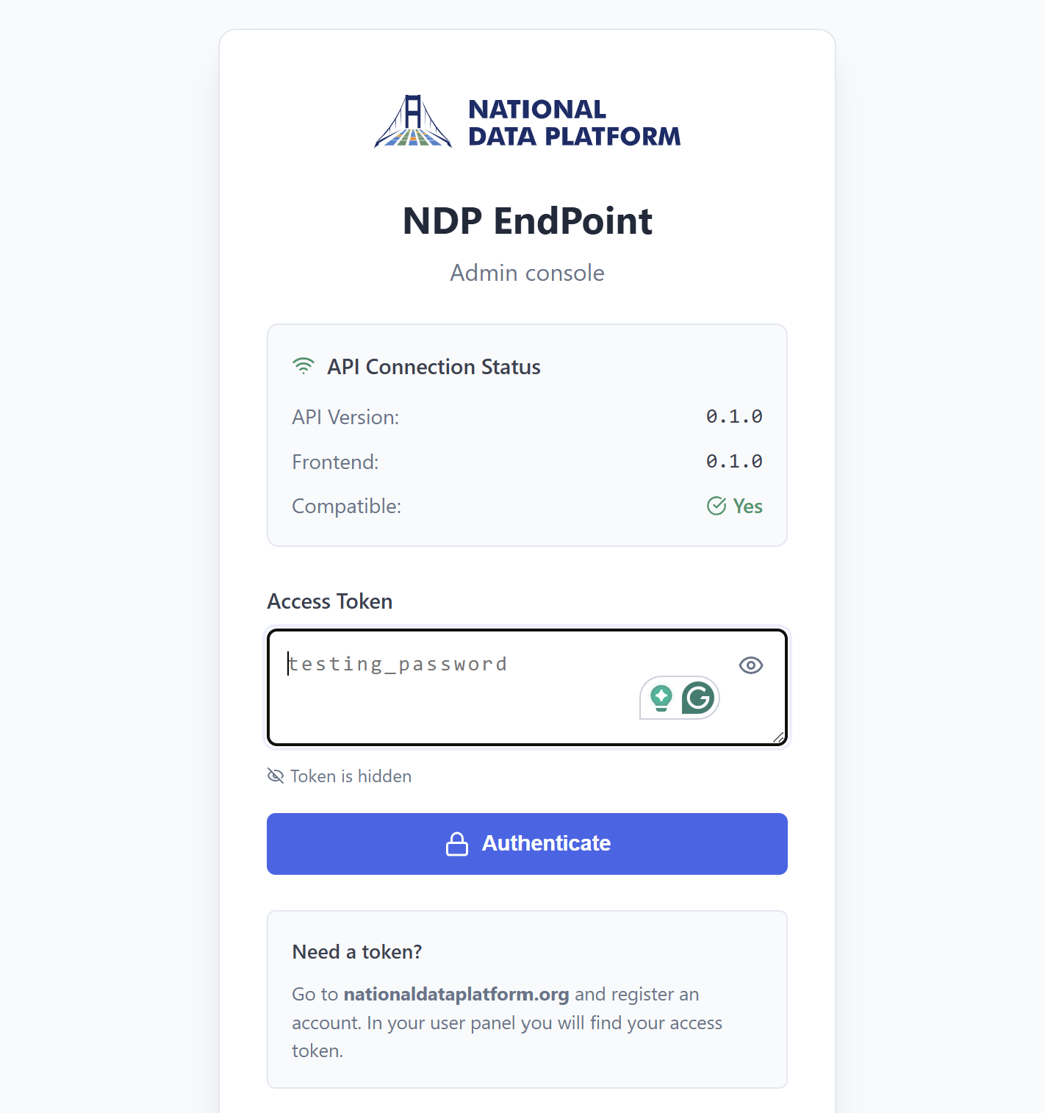
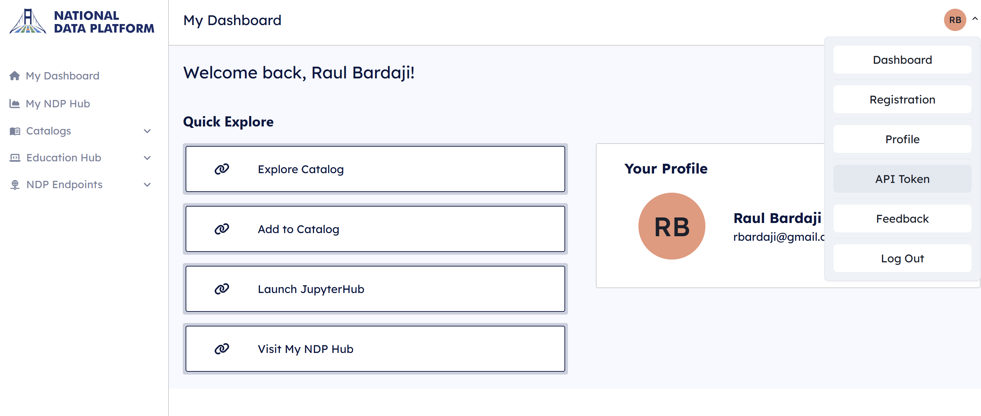
https://nationaldataplatform.org/

Slide 15
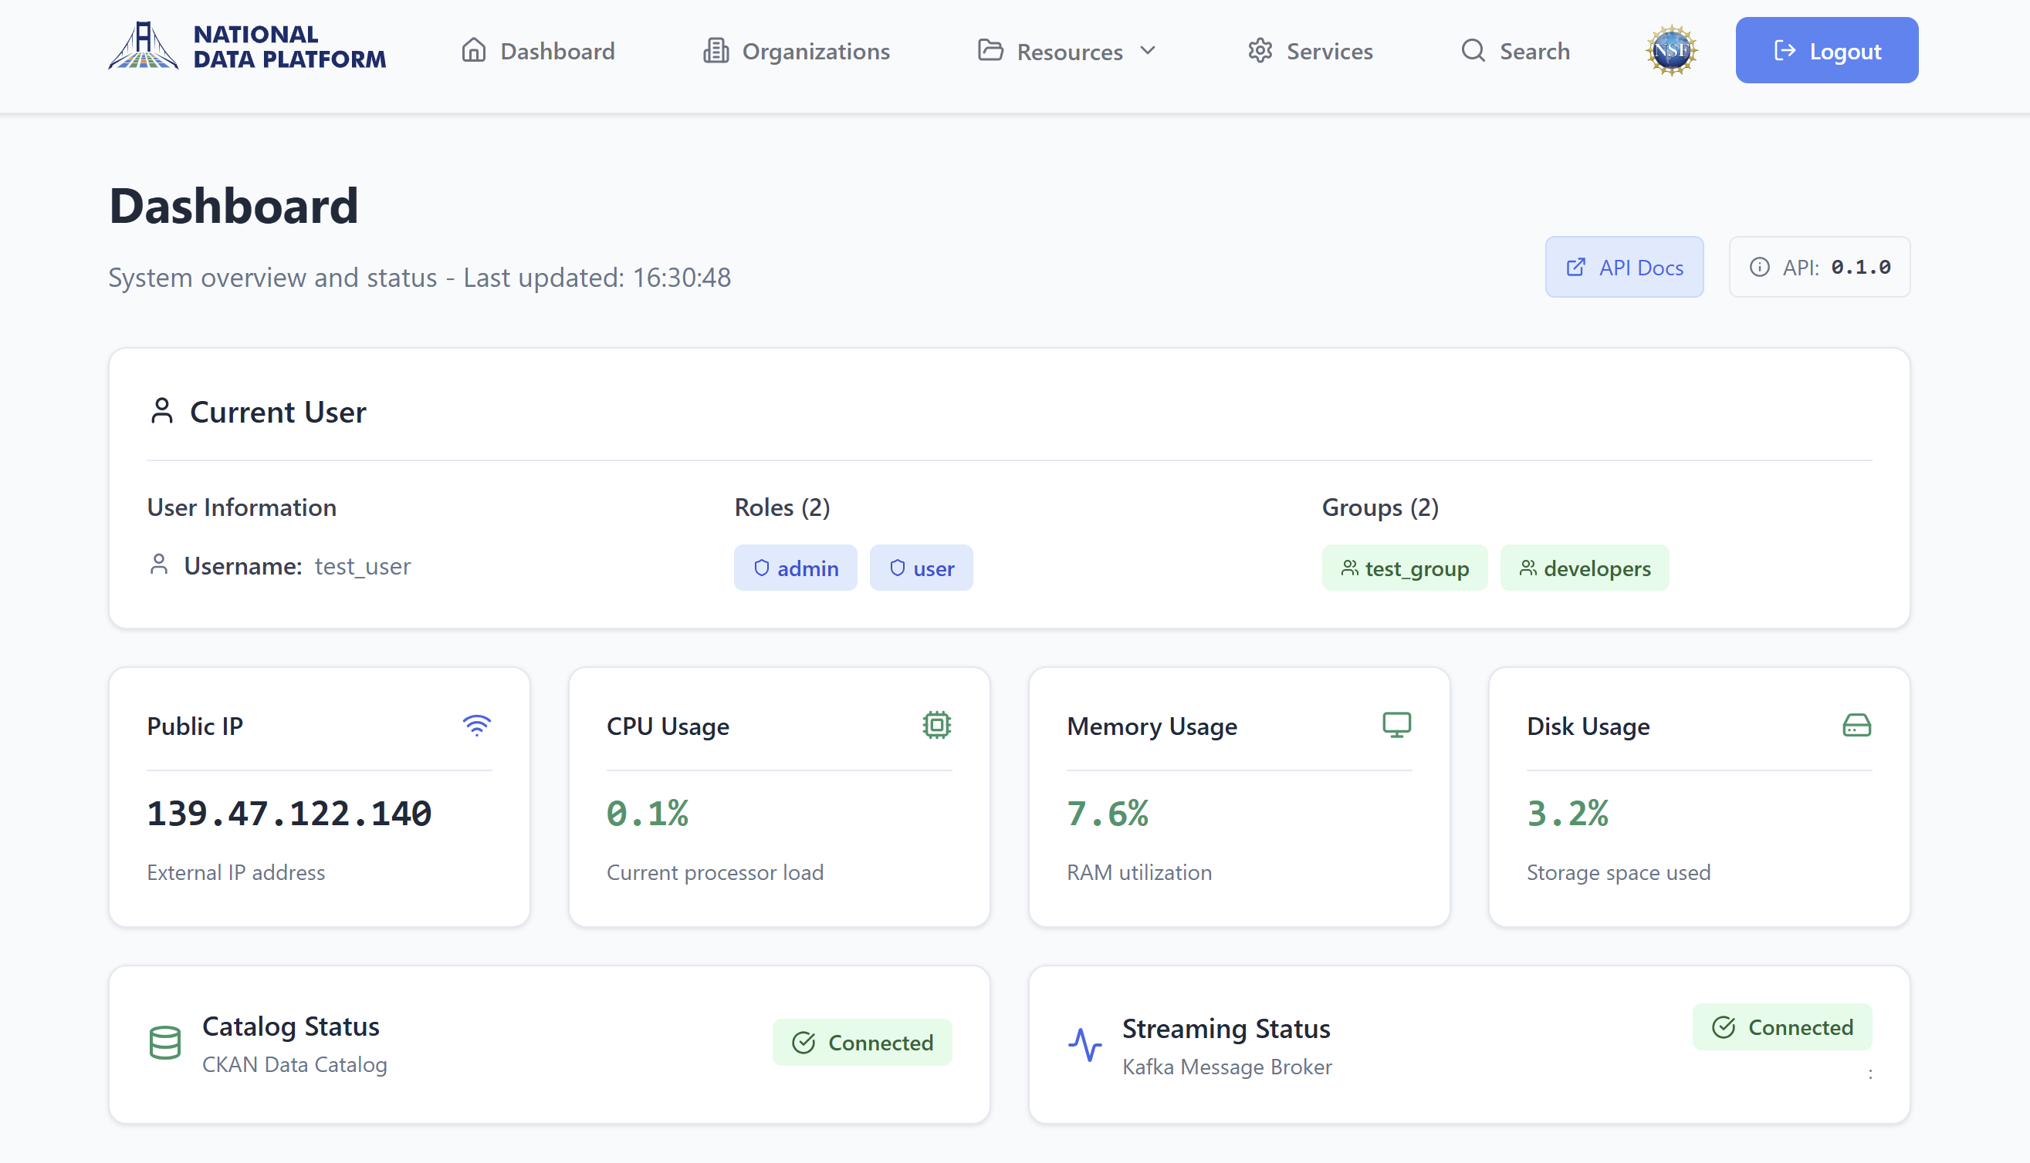

Slide 16
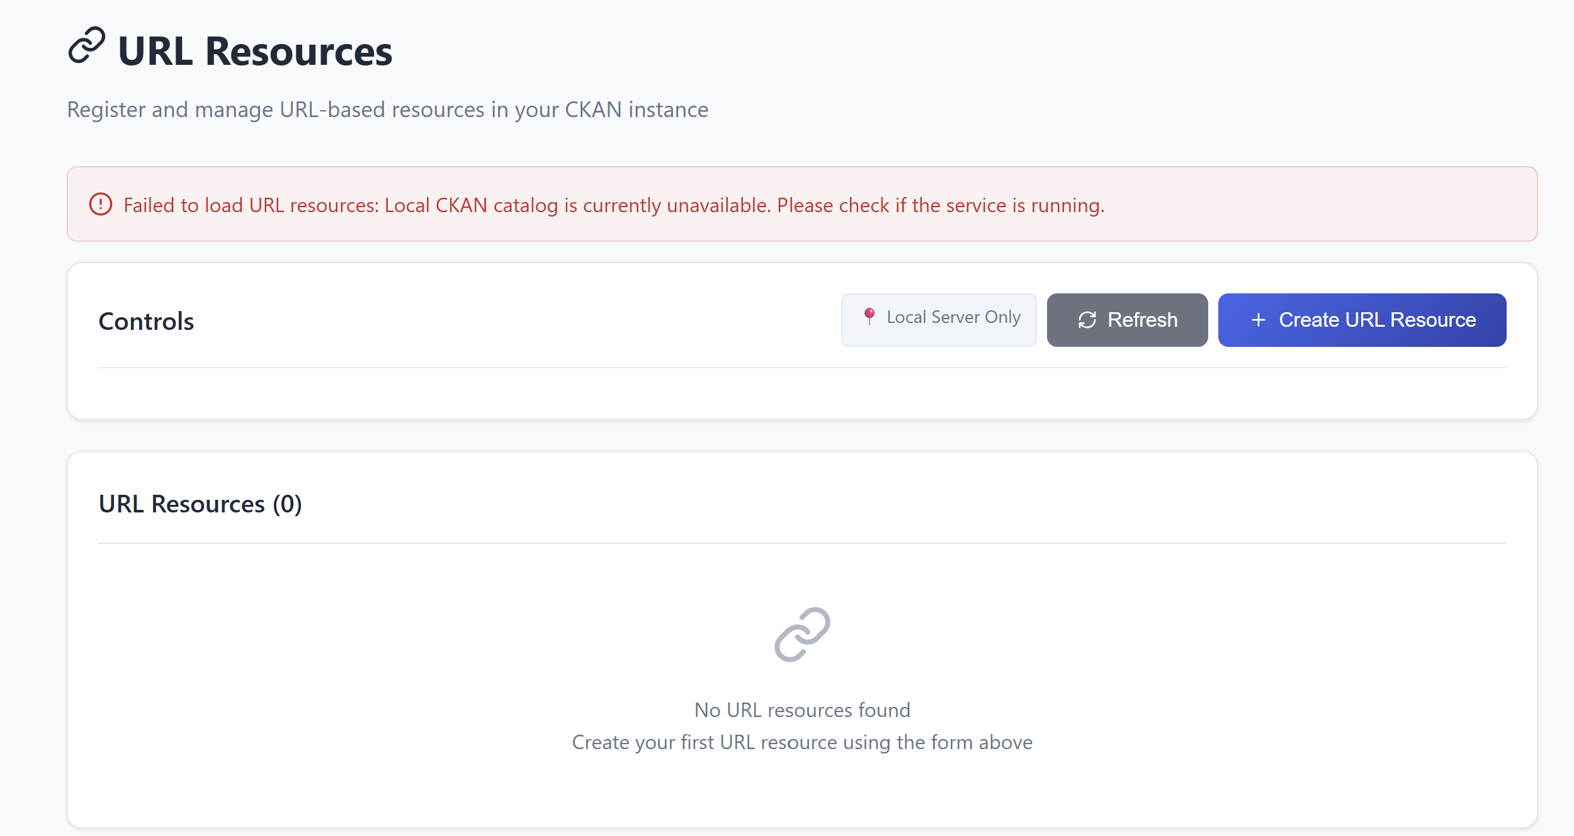
The frontend monitors system health and
diagnoses component failures.

Slide 17
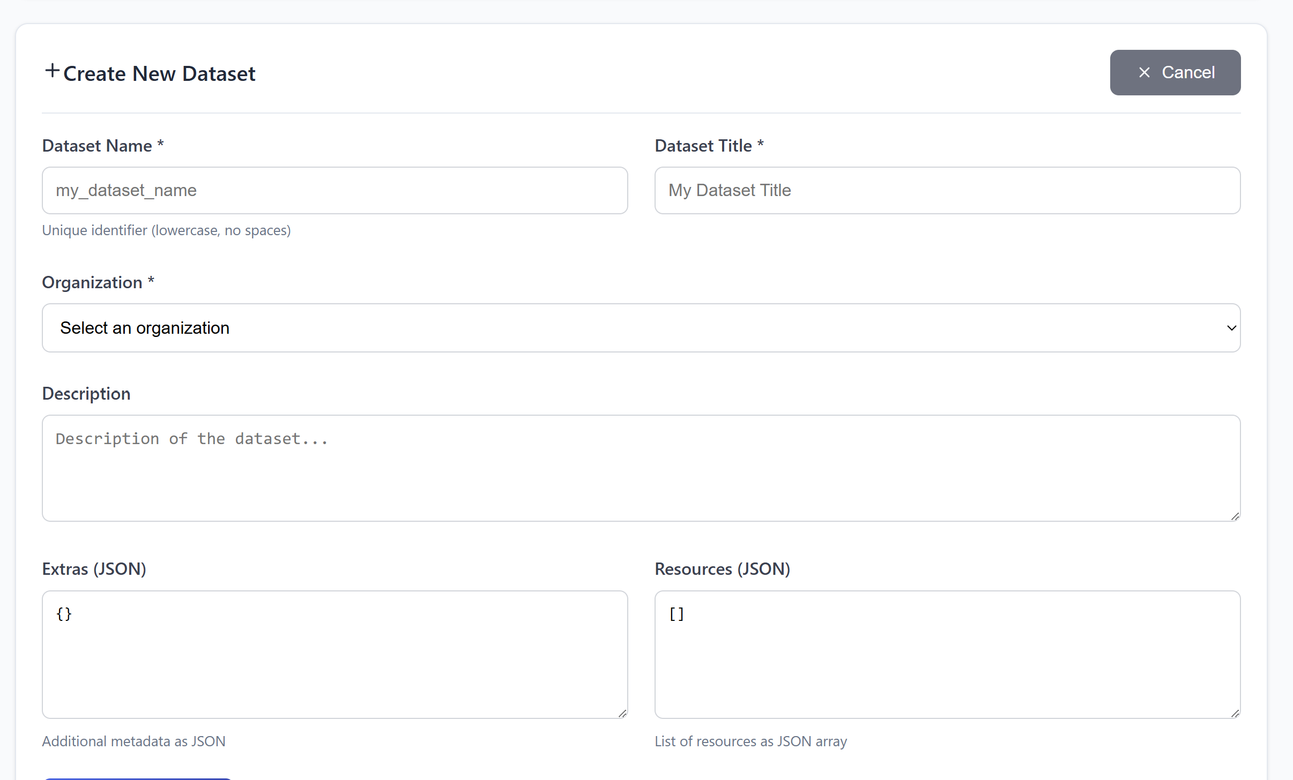

Slide 18
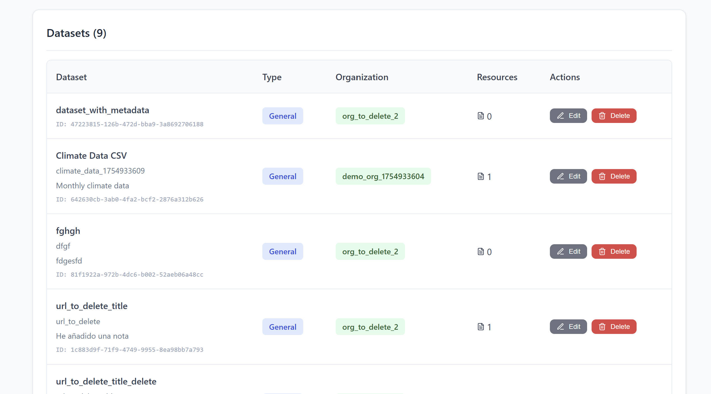

Slide 19
Dataset Publication Workflow
Local Development
Local CKAN Instance
User registers and develops dataset in their own CKAN
Full control: create, update, test, and refine data
Private workspace for experimentation and preparation
Submission for Review
Pre-CKAN Staging Environment
User submits dataset through NDP EndPoints
NDP team reviews submission for approval
Public Publication
NDP Central Catalog
Approved datasets promoted to main NDP catalog
Publicly accessible to all platform users
From Private Development to Public Access

Slide 20
Service Publication Workflow
Register a Service
Additional metadata information
Use the Service
Publish to NDP Central Catalog
Once the service is registered in the system, users can access all its functionalities through the END-EP service proxy
Register Service to Pre-CKAN
Service URL
Service identification name
User registers the service in the local CKAN instance by providing:

